Slide 1
VEHICLE ROUTING OPTIMIZATION PROBLEM IN LOGISTICS AND SUPPLY CHAIN management
Mića Đurđev*, Luka Đorđević, Borivoj Novaković,
Eleonora Desnica, Mihalj Bakator, Stefan Ugrinov
University of Novi Sad, Technical Faculty “Mihajlo Pupin”, Zrenjanin, Republic of Serbia
The Vehicle Routing Problem (VRP) is a fundamental optimization challenge in logistics and supply chain management, directly affecting transportation efficiency and operational costs. This paper provides a brief review of supply chain management (SCM) and its connection to logistics, emphasizing the importance of vehicle routing optimization. The study introduces VRP as a key optimization problem, outlining its role in minimizing delivery costs and improving distribution networks. Various VRP variants, such as Capacitated VRP (CVRP), are briefly presented to illustrate the problem’s complexity and real-world relevance, followed by a mathematical model of the CVRP. The paper explores solution methods, comparing exact, heuristic, and metaheuristic algorithms, and evaluating their effectiveness in solving large-scale VRP instances. Additionally, recent advancements integrating machine learning (ML) techniques, including reinforcement learning and deep learning, are highlighted, demonstrating their potential for dynamic and real-time VRP optimization.

Slide 2
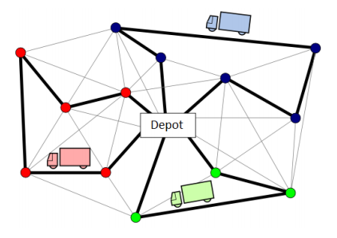
Vehicle Routing Problem (VRP)
Vehicle Routing Problem (VRP) is a combinatorial optimization problem that seeks to determine the most efficient routes for a fleet of vehicles delivering goods to a set of customers. As illustrated, each node represents a customer, and vehicles, starting from a central depot, must deliver goods to each customer before returning to the depot. Similar to the TSP, the VRP belongs to the class of NP-hard optimization challenges, meaning that as the number of customers increases, the computational complexity grows exponentially, making exact solutions impractical for large instances.

Slide 3
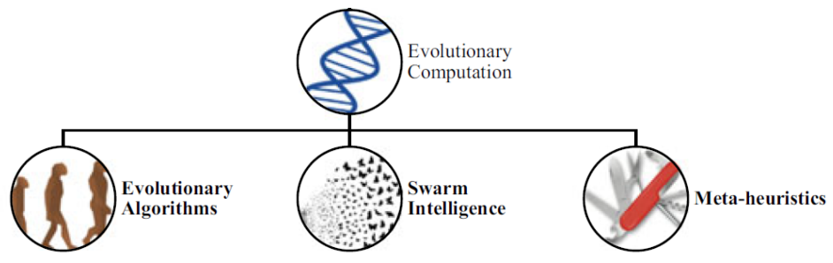
SOLUTION METHODS OF VRP
The VRP has been extensively studied in the literature, leading to the development of various solution methods categorized into exact, heuristic, and metaheuristic approaches, as well as machine learning methods.
The most effective approaches for large-scale VRPs are metaheuristic algorithms. Metaheuristic algorithms, or metaheuristics in short, represent the high-level optimization techniques designed to efficiently explore large solution spaces, balancing exploitation (local search) and exploration (global search) to avoid local optima. Unlike exact algorithms, metaheuristics are stochastic algorithms which do not guarantee an optimal solution but provide high-quality approximations within reasonable computational time, making them ideal for complex combinatorial problems such as the VRP.

Slide 4
CONCLUSION
This study provided a brief review of popular Vehicle Routing Problem (VRP) and its significance in logistics and supply chain management, focusing on optimization strategies to improve cost efficiency and service quality. As derived from the traditional travelling salesman problem from the point of its complexity, VRP is introduced with its different variants. As solution methods for solving the VRP and its variants, techinques such as exact algorithms, heuristics and metaheuristics are proposed. While exact algorithms ensure optimality, their practical limitations in large-scale scenarios necessitate the use of heuristic and metaheuristic approaches, which offer high-quality approximations with reasonable computational effort. Recent advances introduced machine learning techniques to further improve VRP solutions, enabling dynamic and data-driven decision-making in modern logistics. As businesses face growing demands for faster and more sustainable transportation, future research should explore hybrid approaches combining metaheuristics, artificial intelligence, and real-time optimization techniques to address the complexities of evolving supply chain networks.

